Slide 1
Introduction to AI And ML in Penetration Testing
Harnessing Artificial Intelligence for Penetration Testing

Slide 2
Course Overview
Explore
Explore Artificial Intelligence, Machine Learning, and Penetration Testing
Engage
Actively Engage with Automated Tools
Reflect
Reflect on Ethical Considerations
Examine
Examine the Broader Implications of AI
Encourage
Encourage Critical and Creative Thinking
goals

Slide 3
Course Overview
Module 1
Introduction to AI and ML in Penetration Testing
Module 2
Machine Learning for Vulnerability Assessment
Module 3
Post-Exploitation AI and ML Techniques
Module 4
Deep Learning and Advanced Techniques
general outline
Notes:
Module 1: Introduction to AI and ML in Penetration Testing
(Introduce AI and ML and their role in Penetration Testing especially pertaining to Gathering Information and Reconnaissanc)
Module 2: Machine Learning for Vulnerability Assessment
(Finding vulnerabilities through automated scanning tools, and AI-Enhanced exploitation techniques)
Module 3: Post-Exploitation AI and ML Techniques
(Maintaining Connection, Privilege Escalation, Covering Tracks, and Reporting and how AI enhances this phase
Module 4: Deep Learning and Advanced Techniques
(Deep Learning and Advanced Techniques)

Slide 4
Course Overview
Reflective Questions
Capture The Flag / Practical Exercises
Final Seminar Project
assessment strategies

Slide 5
Penetration Testing
“A method of evaluating the security of computer systems or networks by simulating an attack by a malicious individual” ^{[1]}
Uncover Weak Points
Understand Potential Attack Scenarios
Analyze Vulnerability Severity
Notes:
2.9 million USD is lost to cybercrime every minute
The average cost of a data breach is 3.86 million
Average time to identify and contain a break was 280 days
[1] S. Watts , Penetration Testing: Practical Introduction & Tutorials, 2022.
[2] "Market Research Report," Fortune Business Insights, 2022.
[3] Market Research Report, MarketsandMarkets, 2022.

Slide 6
Penetration Testing
Splunk
Log Management
Historical Analysis
Reporting and Documentation Features
So Much More!
Phases
Preparation
Implementation
Analysis
Notes:
preparation, implementation, analysis [4]
[4] H. M. Z. A. Shebli and B. D. Beheshti, "A study on penetration testing process and tools," in Long Island Systems, Applications and Technology Conference (LISAT), Farmingdale, 2018.

Slide 7
Penetration Testing
Phases
Gather Information
Scanning
Exploitation
Maintaining Access
Covering Tracks
Reporting and Documentation
Preparation
Implementation
Analysis

Slide 8
Machine Learning
Develop Algorithms that Mimic ‘Human Cognition’ Abilities to Solve Complex Problems without Explicit Programming

Slide 9
Machine Learning
Supervised Learning
Predict New Data from Labeled Data
Prediction, Classification
Unsupervised Learning
Predict New Data from Patterns in Unlabeled Data
Pattern Recognition, Clustering

Slide 10
Machine Learning
Reinforcement Learning
Autonomously learns through Action And Reward
Maximizes Cumulative Rewards Over Time
Q-Learning
Deep Q-Learning

Slide 11

www.Kaggle.com

Slide 12
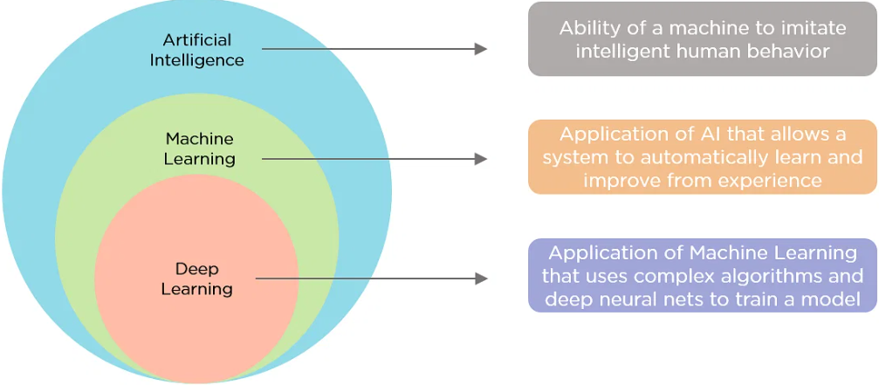
Artificial Intelligence
The Creation of Machines
to Mimic Intelligent Human Behavior
Weak (Narrow) AI
Single Task
Siri, Alexa, Image Recognition, LLM
Strong (General) AI
Meet or Surpass Human Intelligence
Theoretical
Notes:
[5] S. Shah and B. M. Mehtre , "An overview of vulnerability assessment and penetration testing techniques," Journal of Computer Virology and Hacking Techniques, pp. 27-49, 18 November 2014.
Photo: [6] N. Duggal, What is Artificial Intelligence: Types, History, and Future, 2023.

Slide 13
Automated pt overview
Constantly Evolving Threats
Modern Network Complexity
IoT
The Cloud
BYoD/ Remote Work
Critical Shortage of Cybersecurity Experts
Reduce Workload
Address Understaffed/trained
Minimize human Errors
Traditional PT Methods Fall Short
Manual
Repetitive
Notes:
[2] "Market Research Report," Fortune Business Insights, 2022.
[3] Market Research Report, MarketsandMarkets, 2022.

Slide 14
Automated pt information gathering
Automate Data Collection
Target Profiling
Identifying Assets
Predicting Vulnerabilities
Examples
Natural Language Processing (NLP)
Reinforcement Learning (RL)

Slide 15
Automated PT scanning
Continuous Monitoring
Prioritization
GyoiThon
Collect Data from Target URLs

Slide 16
Automated pt exploitation
Traditional Methods
Rigid
Exhaustive
Resource Intensive
Real-Time Adaptability
Reinforcement Learning
Experience Replay
Social Engineering
Phishing
Large Language Model (LLM)

Slide 17
Automated PT post-exploitation
Counteract Detection and Mitigation
Emulates Normal Network Traffic Patterns
Counteracts Anomaly Detection
Erases Log Files To Cover Tracks
Report Generation

Slide 18
Research Question
What are some key advantages of using AI in the information gathering phase, and how does it enhance the accuracy and efficiency of the process?

Slide 19
References
S. Watts , Penetration Testing: Practical Introduction & Tutorials, 2022.
"Market Research Report," Fortune Business Insights, 2022.
Market Research Report, MarketsandMarkets, 2022.
H. M. Z. A. Shebli and B. D. Beheshti, "A study on penetration testing process and tools," in Long Island Systems, Applications and Technology Conference (LISAT), Farmingdale, 2018.
N. Duggal, What is Artificial Intelligence: Types, History, and Future, 2023.
S. Shah and B. M. Mehtre , "An overview of vulnerability assessment and penetration testing techniques," Journal of Computer Virology and Hacking Techniques, pp. 27-49, 18 November 2014.
S. Morgan, Cybersecurity Jobs Report: 3.5 Million Unfilled Positions In 2025, Sausality, California, 2023.
N. Kühl, M. Schemmer, . M. Goutier and G. Sat, Artificial intelligence and machine learning, 2022, pp. 2235-2244.
S. Morgan, 2023 Cybersecurity Almanac: 100 Facts, Figures, Predictions, And Statistics, Sausality, California, 2023.
A. Almajali, . L. Al-Abed, R. Mutleq, Z. Samamah, A. Issa Abu Shhadeh, B. Jamil Mohd and K. M. Ahmad Yousef , "Vulnerability Exploitation Using Reinforcement Learning," in Jordan International Joint Conference Electrical Engineering and Information Technology, 2023.
Notes:
Thank you!

